Slide 1
Statistical Tools and Concepts for Molecular Biologists
Data into Insights Part 2: Probability & Hypothesis Testing

Slide 2
Analyzing data to gain insight into our world (Sessions 1-3)
Inferring population traits from a random sample
Statistical summaries
Distributions
Hypothesis testing and p-values
Multiple testing, p-hacking, and permutations

Slide 3
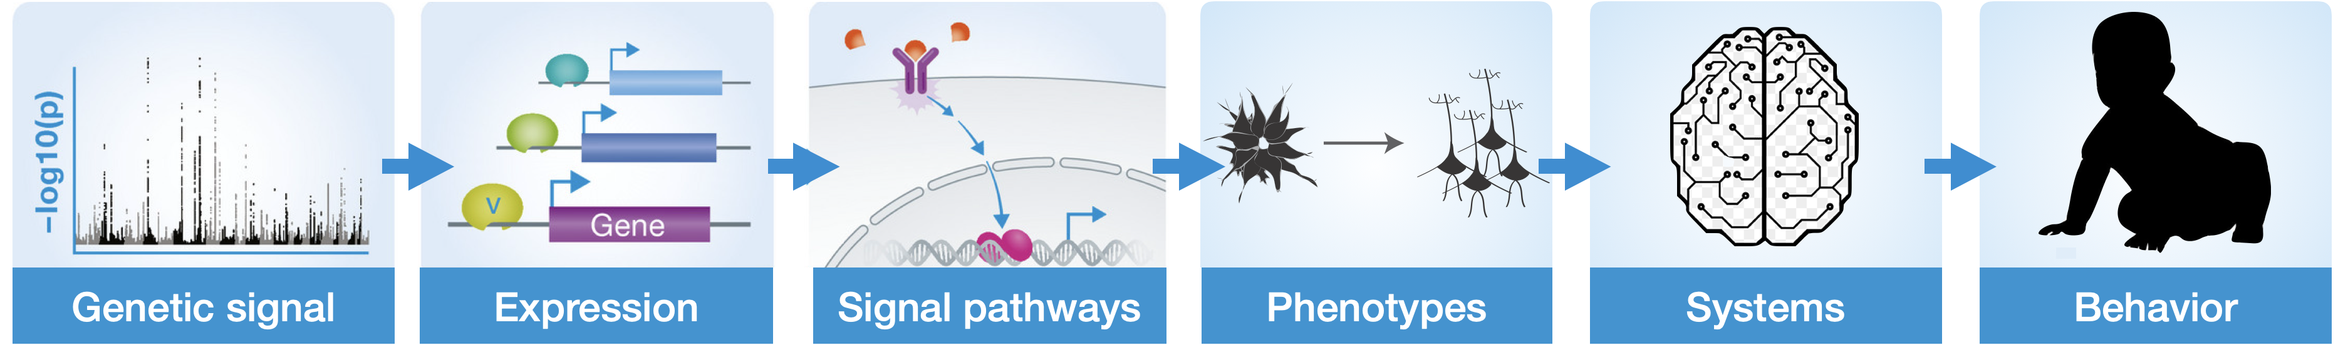
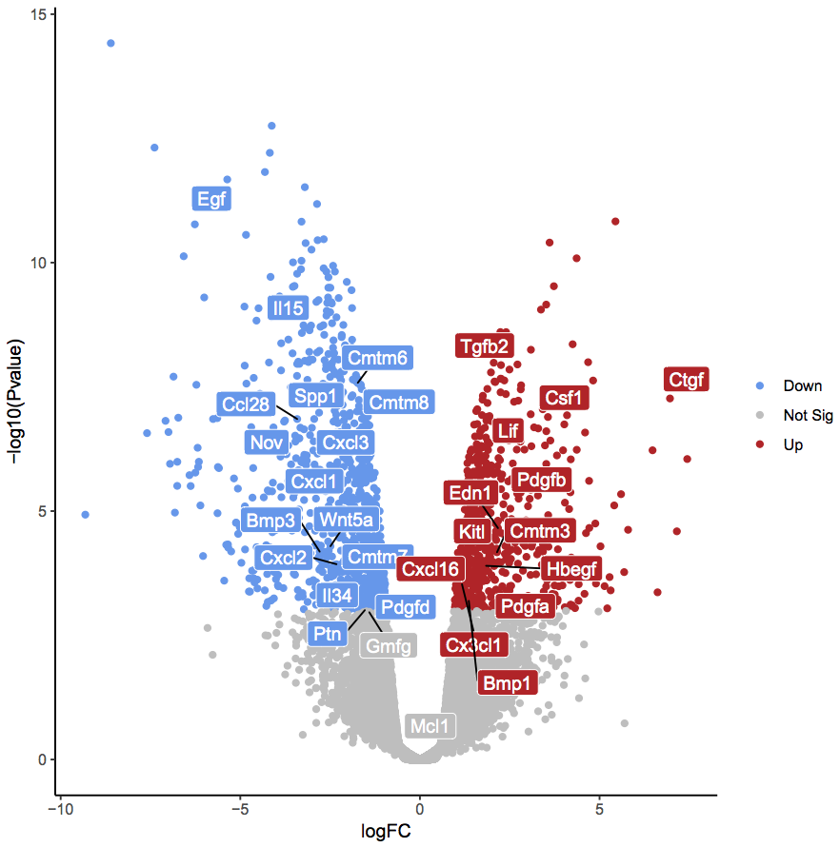
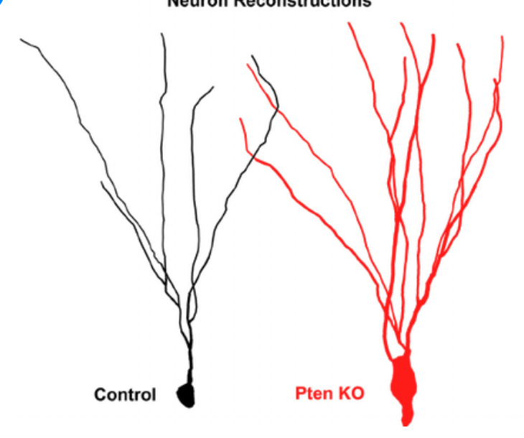
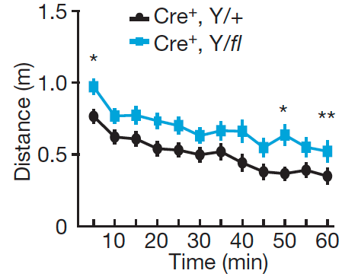
The power of being equipped with statistical tools
How do we make conclusions about differences between groups?
Control
Knockout

Slide 4
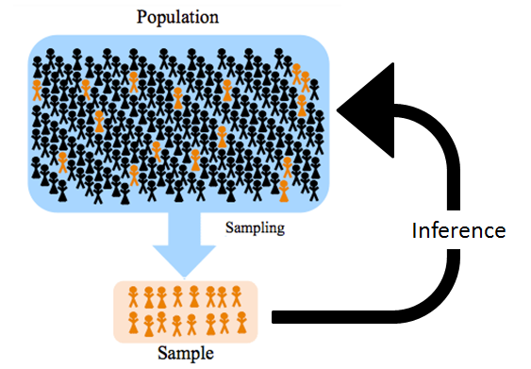
Inferential statistics: Sample to population
In most cases, it is impossible to collect data from the entire population.
We therefore sample the population and then draw conclusions about actual population from small sample
There is uncertainty in our conclusions that is typically reflected in a probability
Notes:
https://www.youtube.com/watch?v=gHCcvynl1YY

Slide 5
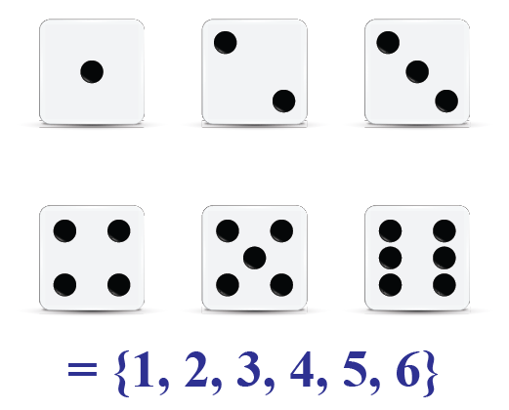
Basics of Probability
Probability (Pr) is a number between 0 and 1 that reflects how likely a future event will occur
Pr(A) = 0: Event A can’t happen
Pr(A) = 1: Event A will happen
Pr(A) = 0.5: Event A is equally likely to happen or not happen
Single event
Pr(4) = 1/6 or 16.67%
Pr(Even) = 3/6 or 50%
Pr(9) = 0
Multiple independent events
Pr(4, 1) = 1/6 x 1/6 or 2.78%
Pr(Even, 3) = 3/6 x 1/6 or 8.33%
Pr(4, 9) = 1/6 x 0 or 0%

Slide 6
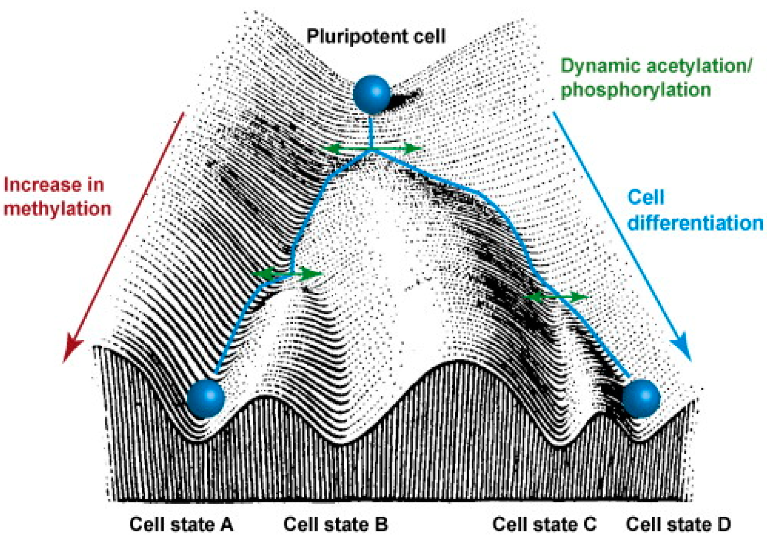
Probability in Nature: Cell differentiation

Slide 7
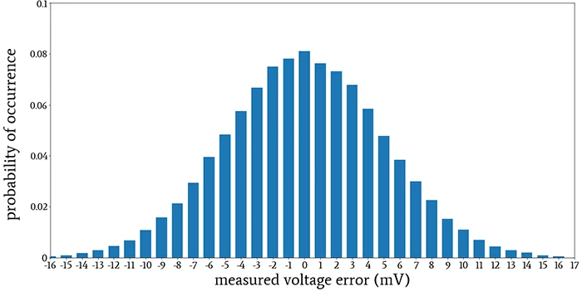
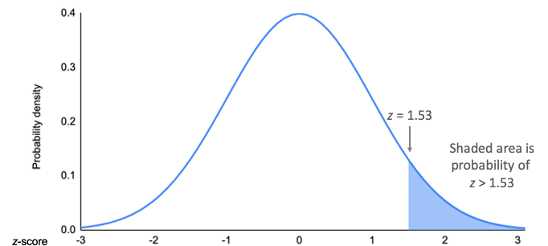
Probability as a measure of certainty
Probability (Pr) is a formal measure of (un)certainty. It is a number between 0 and 1 that reflects how likely a belief is true.
Pr(A) = 0: You are absolutely sure that Statement A is wrong
Pr(A) = 1: You are absolutely sure that Statement A is correct
Pr(A) = 0.5: Statement A is equally likely to be true or false
This measure of Pr is often modeled as a probability distribution

Slide 8
Probability vs. Inferential Statistics
The terms probability and statistics are often confused with each other, but they are distinct
Probability starts with the general case (population or model) and predict what will happen in a sample data set
Inferential statistics start with the sample data set and make conclusions about the overall population or model
Probability
Statistics
General
Specific
Population
Sample
Model
Data
Notes:
Probability is a theoretical branch of math while stats is applied
Probability deals with prediction of future events while stats analyze frequency of past events

Slide 9
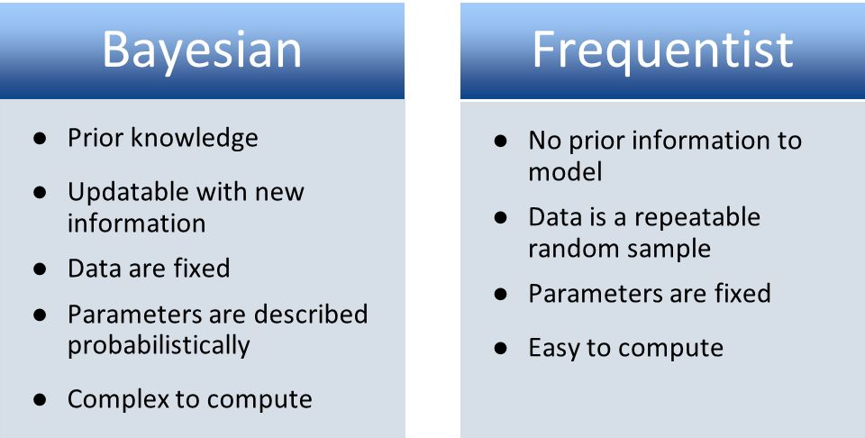
Frequentist vs. Bayesian Inference
There are two types of inferential statistics that differ in their interpretation of probability
Frequentist inference is based on repeating measurements from a population and drawing conclusions
The frequency of a value indicates the probability of measuring that value
Tests hypotheses and computes p-values
Bayesian inference is based on our knowledge of events and their effects on the probability of other events
Specifies a probability based on prior knowledge
Can update probabilities as new data is observed
Notes:
Missing cell phone example: https://towardsdatascience.com/what-is-bayesian-inference-4eda9f9e20a6
Frequentists: probability is objective, so let’s calculate Pr by counting frequencies of events
Bayesians: Pr is subjective, so let’s understand Pr as degrees of belief

Slide 10
Fundamentals of Hypothesis Testing
A statistical hypothesis is an assumption about a population parameter (e.g. mean = 10) that may or may not be true
Hypothesis testing is a statistical tool to calculate the probability that a given hypothesis is true.
Allows us to accept or reject the statistical hypothesis
This is a form of statistical inference that uses data from our sample to make conclusions about the population parameter
Can be used to determine if the results of your experiment are “meaningful”
Commonly used to compare two or more groups to each other and assess statistical significance of differences (you have to decide if these differences are biologically significant though)
Outputs include p-values

Slide 11
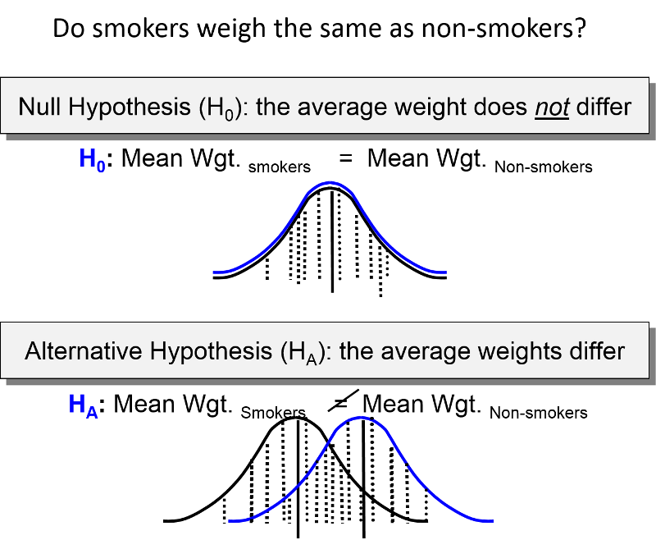
Null vs. Alternative Hypothesis
The null hypothesis (H₀) is the hypothesis that the sample observations are purely by chance or that there is no difference between groups.
The alternative hypothesis (H_{A}) is the hypothesis that the sample observations are affected by a non-random factor by chance or that there is a meaningful difference between groups.
Notes:
As a default, you assume that the null hypothesis is valid until evidence suggests otherwise. Similar to innocent until proven guilty—it is better to let many guilty people go then falsely convict one innocent person.

Slide 12
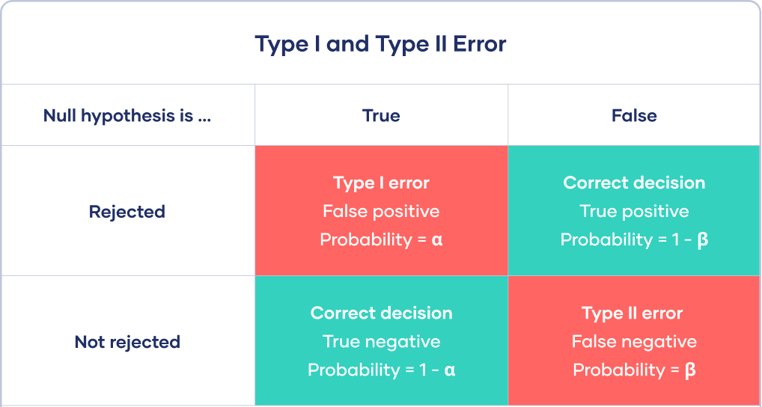
Possible Outcomes of Hypothesis Testing
Power (1 - β) is the probability of finding group differences if they actually exist
Notes:
Type 1 error = incorrectly reject the null, meaning you are saying there is a difference when there isn’t. We focus on minimizing type 1 error because it is often more detrimental to conclude differences when they are not actually there than it is to falsely fail to reject the null when there are actual differences (false negative, type II).
Probability of making a type 1 error is alpha. Typically set alpha to 0.05 to indicate level of significance
Having B less than 20% is good, so you want power around 80% or 0.8. Can often run power calculations prior to running experiment.
Power increases with sample size and effect size.

Slide 13
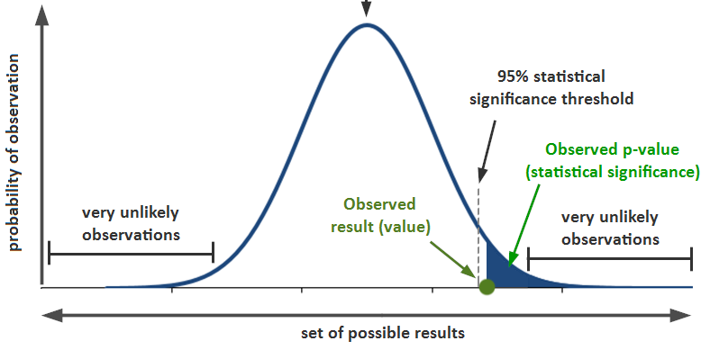
Statistical Significance & p-values
Statistical significance is a measure of the probability of the null hypothesis being true compared to a pre-determined acceptable level of uncertainty
Level or threshold of significance is often set to 0.05 and denoted by ⍺
Statistical significance does not automatically mean biological significance
The p-value is the probability of observing (in the future) a difference or association as large or larger than the current observation under the assumption the null hypothesis is true.
Notes:
0.05 threshold is a somewhat arbitrary cutoff that researchers have coalesced around. It is basically saying that we are ok with having a 5% chance of a false positive.
https://www.youtube.com/watch?v=YSwmpAmLV2s

Slide 14
PITFALL: Misinterpretation of the p-value
Our H₀ = group means are equal. We calculate a difference of 150 between the two groups and a p-value = 0.03
What can we conclude?
There is only a 3% chance that we would observe a difference of 100 or more in another random sampling if group means are actually identical
Therefore, the groups are highly unlikely to be the same
The p-value is NOT:
The probability that your result is true
Wrong: “My results are 97% likely to be true”
The probability that there are differences between your groups
Wrong: “There is a 97% chance that these groups are different”
Notes:
Standard deviation vs standard error: https://www.youtube.com/watch?v=A82brFpdr9g
SEM is not necessarily a measure of the variation of the data you measured.

Slide 15
Statistical Comparisons Between Groups
Let’s compare the proliferation dynamics of two groups of cells in terms of doubling time (Dt), where a shorter Dt reflects faster proliferation
Group A: Control cells that have no known mutations in cell cycle genes
Group B: Cells harboring a deleterious P53 mutation
Ctrl | P53^{mut}
38 | 19
42 | 23
34 | 21
35 | 11
41 | 17
Group | Mean | SD
Ctrl | 38 hours | 3.5 hours
P53^{mut} | 18.2 hours | 4.6 hours
H₀: Mean_{CTRL} = Mean_{P53MUT}
⍺ = 0.05

Slide 16
Statistical Comparisons Between Groups
We now formally assess the null hypothesis using a statistical test
There are many types of statistical tests that are commonly used for specific assessments
This will be covered more in-depth in Lecture 6
For now, all you need to know is that to compare the means two groups (assuming a normal distribution), we can run a t-test
p = 0.0000615
If we repeated this experiment, there is a 0.0006% chance that we would observe a difference in means of 19.8 hours or more if these two groups actually had the same mean.
p < 0.05, so we can reject the null hypothesis and conclude that the group differences are statistically significant
Doubling time (hrs)
If p ≥ 0.05
We would fail to reject the null hypothesis and conclude that there is not evidence that groups differ
Ctrl P53
Notes:
Remember, at no point can we prove anything to be true. We can only reject H0 or fail to reject it. When rejecting the null hypothesis, you are basically saying that it is highly improbable that there are no differences between the groups.

Slide 17
Biological Insight from Sample Population
Summarize information (Lecture 1)
Central tendency
Variation
Distributions
Confidence (Lecture 2)
Probabilistic statements
Hypothesis testing
p-values

